Slide 1

Natural Language Processing BHI Youth Awards

Slide 2

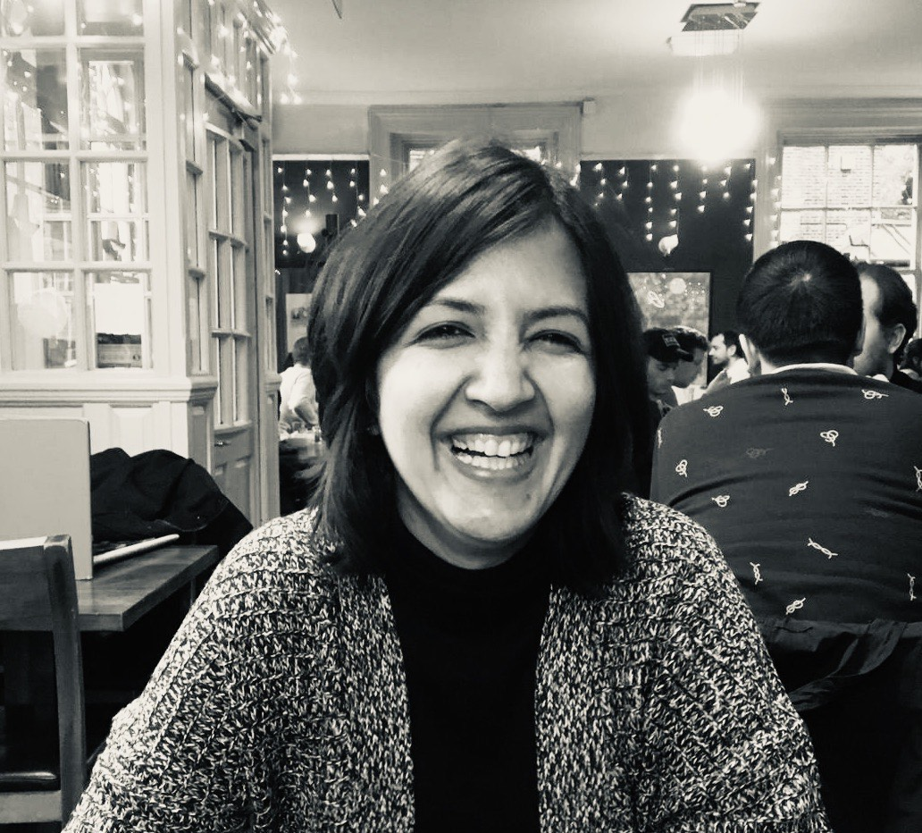
Introduction
Angus Roberts
Senior Lecturer in Health Informatics
Jaya Chaturvedi
Research Associate in health related Natural Language Processing

Slide 3
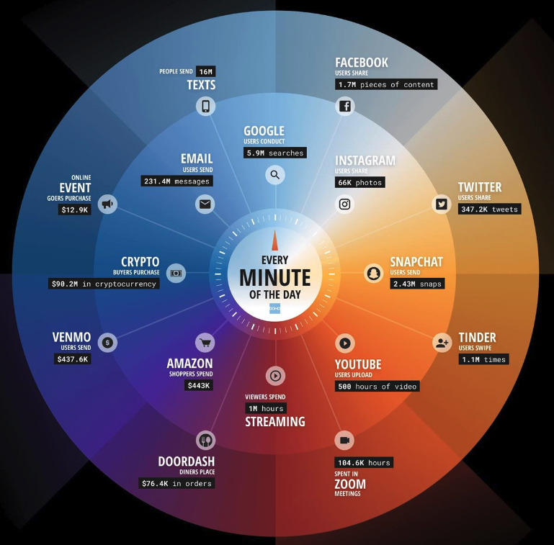
Text is everywhere
Data Never Sleeps 10.0 from domo.com (April 2022)

Slide 4
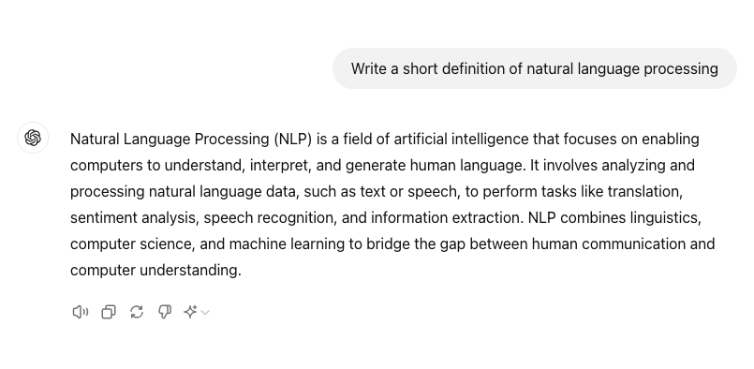

Generative AI

Slide 5
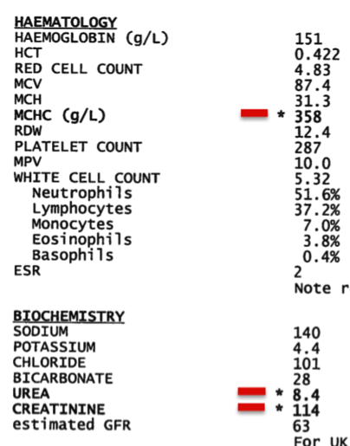
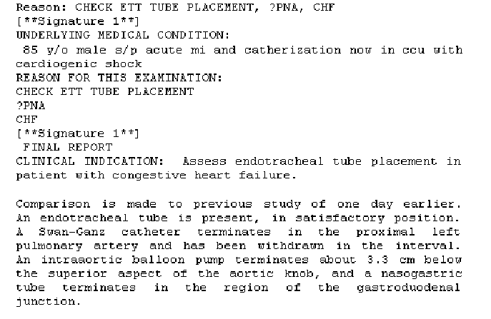
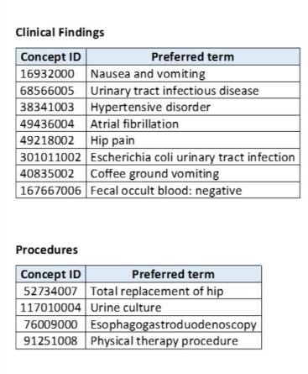
Electronic health records (EHRs) – structured and unstructured information

Slide 6
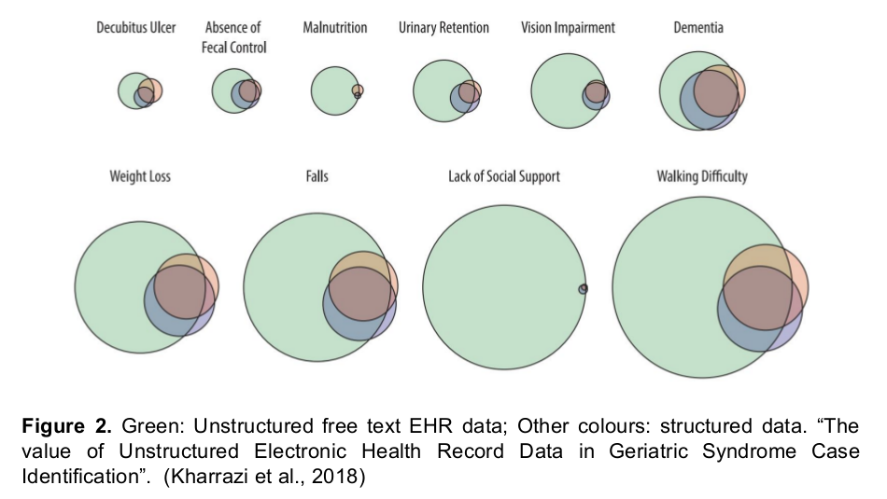
How much unstructured, textual information is in an EHR?

Slide 7
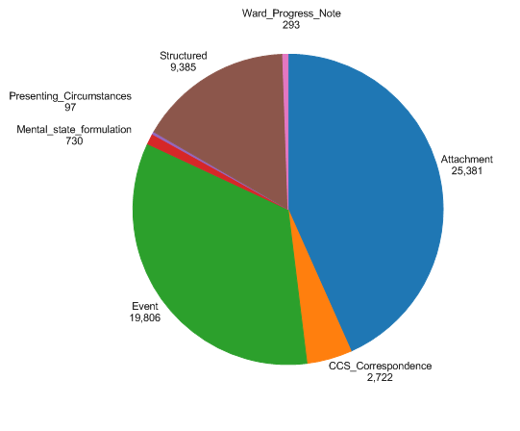
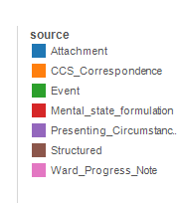
An example – Mini Mental State Examinations

Slide 8
Thank you
angus.roberts@kcl.ac.uk https://www.kcl.ac.uk/people/angus-roberts

